Slide 1
An application specific comparison of Real Time Scheduling Algorithms for failing task sets
Abhijit Kulkarni &
Bhargava Kolanupaka

Slide 2
Overview
A two vehicle system with a Master car and a Servant car is built so as to replicate a platooning system, where servant car follows the Master car.
Implemented, compared and analyzed the three Real-Time scheduling algorithms: RM, DM, and EDF with non-ideal task sets (tasks which fail to execute randomly) on the two OSEK compliant cars (NXT Lego Mindstrom robots).

Slide 3
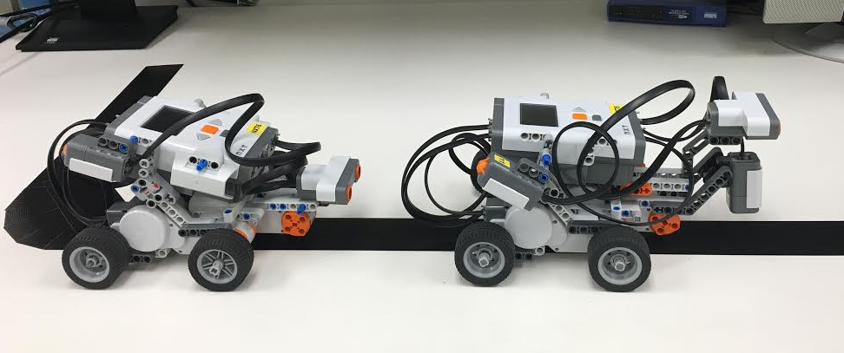
Test setup
Master car and Servant car

Slide 4
Real-time scheduling algorithms
RM
The Rate Monotonic (RM) algorithm is a procedure for assigning fixed priority to each task according to its period, shorter the period higher the priority.
DM
The Deadline Monotonic (RM) algorithm is a procedure for assigning fixed priority to each task according to its relative deadline, shorter the deadline higher the priority.
EDF
The Earliest Deadline First (EDF) is a dynamic priority algorithm, which assigns priorities to the jobs of the periodic tasks according to their absolute deadlines. So, each job of a task has a different priority.

Slide 5
Task set of Two cars
Master car
Servant car
Bluetooth task (background task)
Motor control task
Light sensor task
Idle task
Initialize task
Calibrate sensor task
Bluetooth task (background task)
Motor control task
Sonar sensing task
Idle task

Slide 6

Non-ideal task sets
The automated vehicle system has interdependent tasks and are bound to have unexpected behaviors
To demonstrate it we focused on the probability that a given task in the task set does not execute successfully

Slide 7
Related work

Slide 8
our contribution

Slide 9
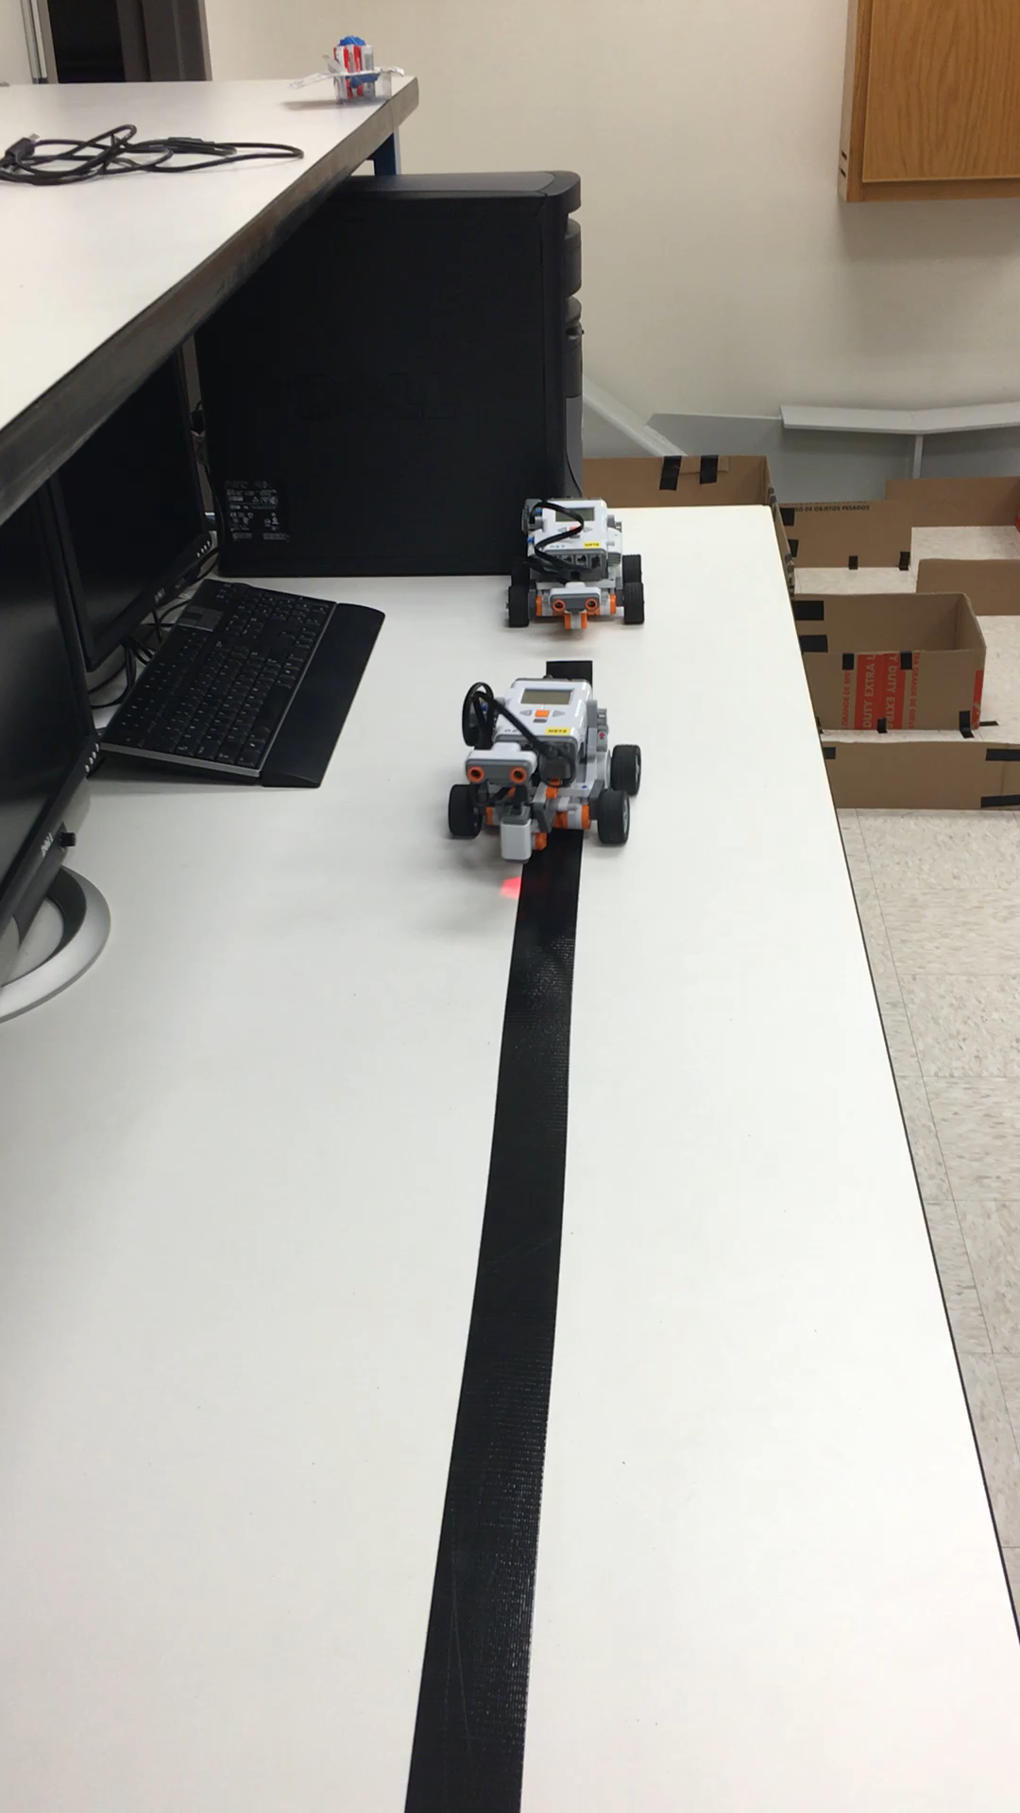
Demonstration

Slide 10
results

Slide 11
Future work

Slide 12
conclusion

